Slide 1
Check in y check out de objetos
Alberto Ismael Alemán Bonfil
Iker Ivan Nuñez González

Slide 2
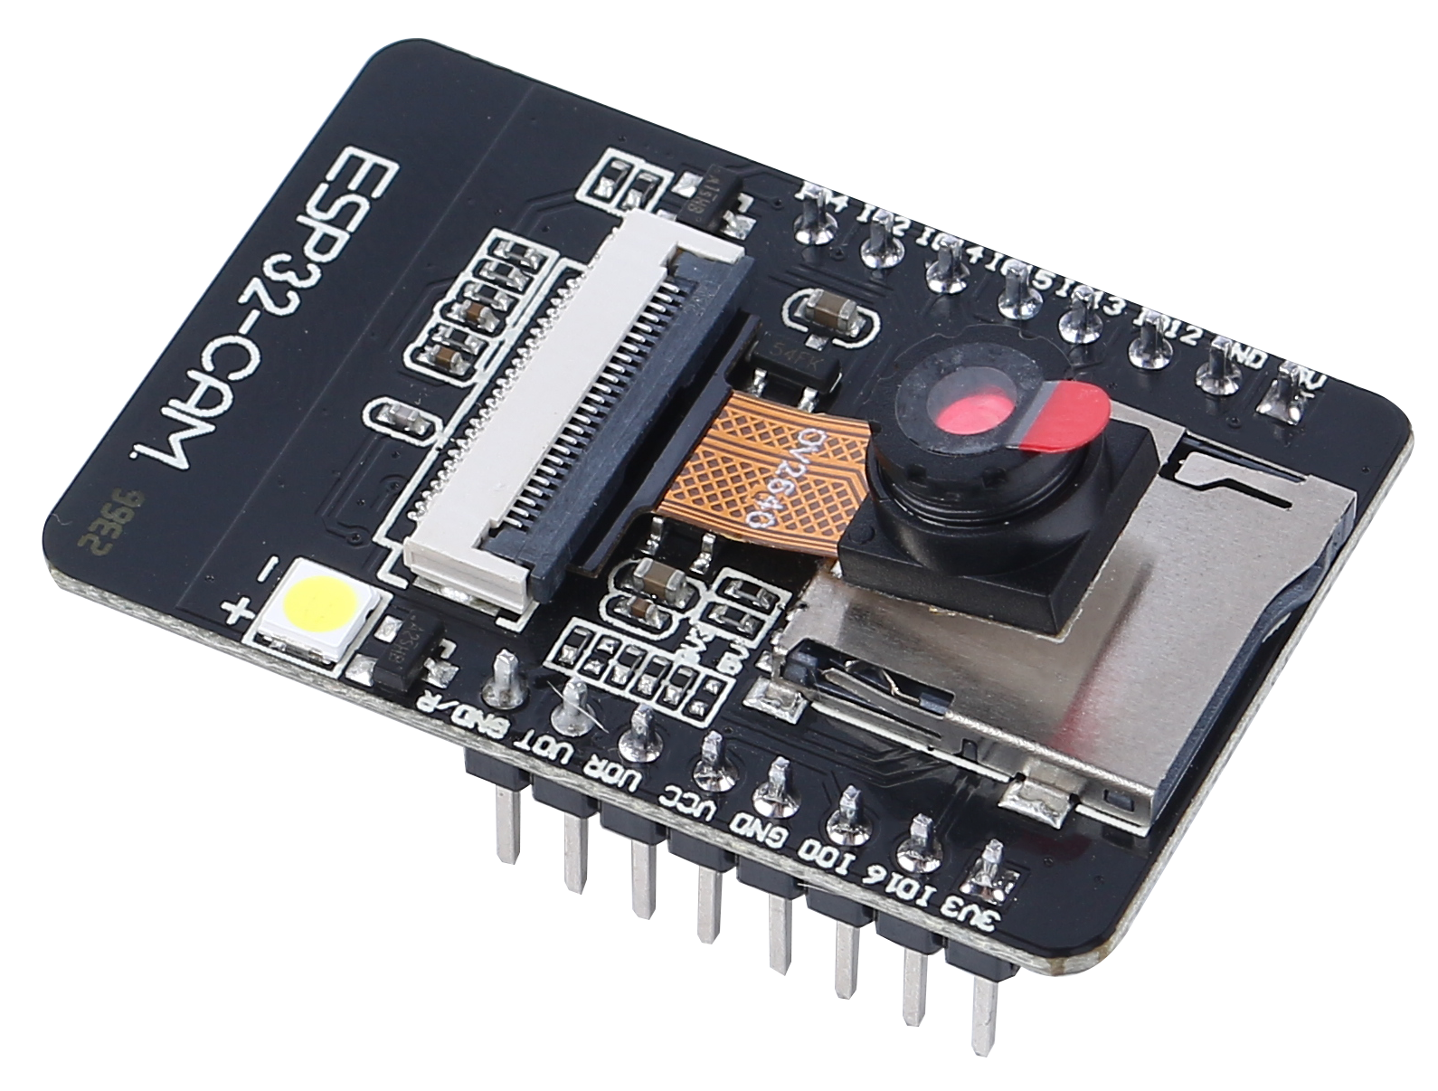
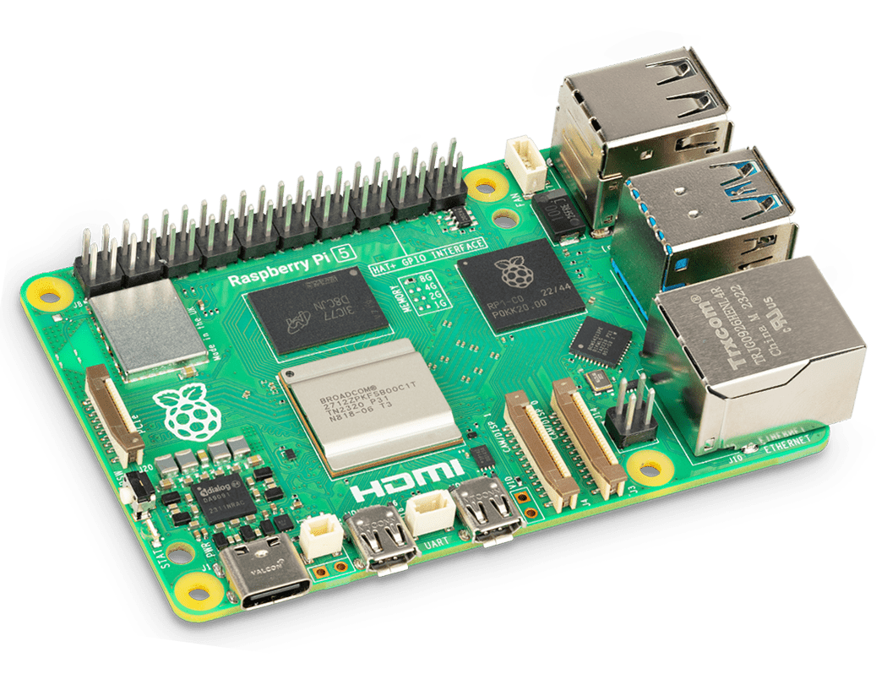
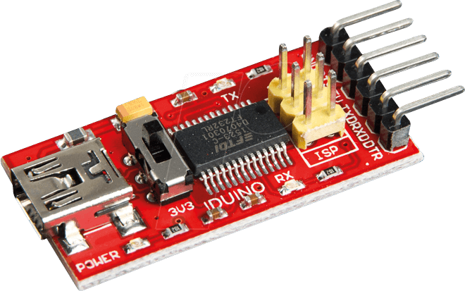
Tecnología utilizada
FTDI TTL USB
Esp32Cam
Rasberry Pi

Slide 3
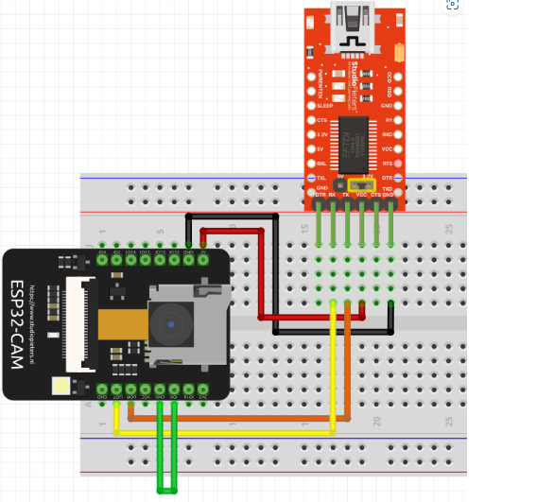
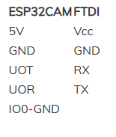
Diagrama de conexiones

Slide 4
Repositorio
IOT
IsmaelAleman17/Proyecto-de-IOT-para-la-resolucion-de-conflictos-de-manejo-de-dispositivos-policiales (github.com)

Slide 5

WHAT WE ARE WORKING ON
SECURE
ACCESSIBLE
FAST AND RELIABLE
Mercury is the closest planet to the Sun
Despite being red, Mars is a cold place, not hot
Neptune is the farthest planet from the Sun

Slide 6
Gracias por ver

